Slide 1


A Systematic Comparison for Consistent Scenario Development Using Microscopic Simulation Software
Date: December 17, 2024
Presenter: Abhilasha Saroj
Authors:
Abhilasha Saroj¹, Guanhao Xu¹, Yunli Shao², Ross Wang¹
¹Oak Ridge National Laboratory;
²University of Georgia
This presentation does not contain any proprietary, confidential, or otherwise restricted information.

Slide 2
Outline
Objective, Background, and Motivation
Overview of Real Twin Tool
Gaps in Literature
Systematic Approach for Comparison across Microsimulation Software
Case Study: Comparison of Scenario across Microsimulation Software – Downtown Chattanooga
Scenario Development
Scenario Performance Evaluation
Case Study: Comparison of Scenario across Microsimulation Software
Conclusion and Future Work
Traffic Simulation Use Case for XIL Cosimulation Demo
Progress in Real-Twin Tool Development

Slide 3
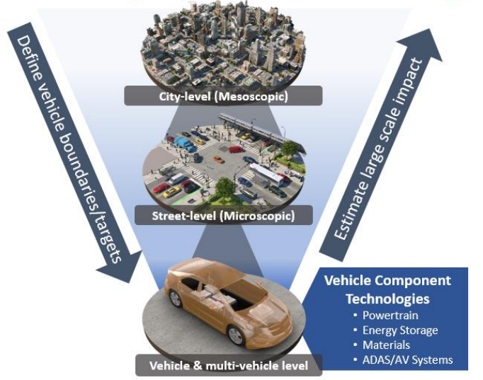
Research Background
Background
Scenarios for mobility research are studied on different platforms by different researchers; A cross-platform benchmark is needed
With the rise in the use of machine learning, deep learning, reinforcement learning algorithm-based applications that are trained on simulation scenarios, it becomes crucial to have a consistent scenario that allows the use of the already developed algorithms on one platform to be used on another platform to further improve the algorithms or provide comparisons with newly developed algorithms
Evaluation and validation of mobility systems
Objective
This study presents a systematic approach to compare the closeness of traffic scenarios developed to study vehicle and traffic control strategies for improved mobility and energy consumption on different microsimulation software platforms.
Notes:
Delivering a unified scenario generation capability that is equipped with well-defined workflows, integrated tools, and comprehensive metrics that streamline the scenario generation process for mobility technology evaluation.
oDescribe the objective of your project and what you were to achieve over the past year in the work covered by your presentation.
oClearly show how your project relates to the pertinent VTO subprogram area and how it will achieve the goals of that area (refer to the subprogram Annual Progress Report goals linked on the next page).
oExplain how your project will be relevant to Reduction of energy costs
Increased energy security
Clean energy technology to move people and goods
oDescribe the impact of your project on addressing the barriersidentified in the Overview slide and other specific targets and milestones.

Slide 4
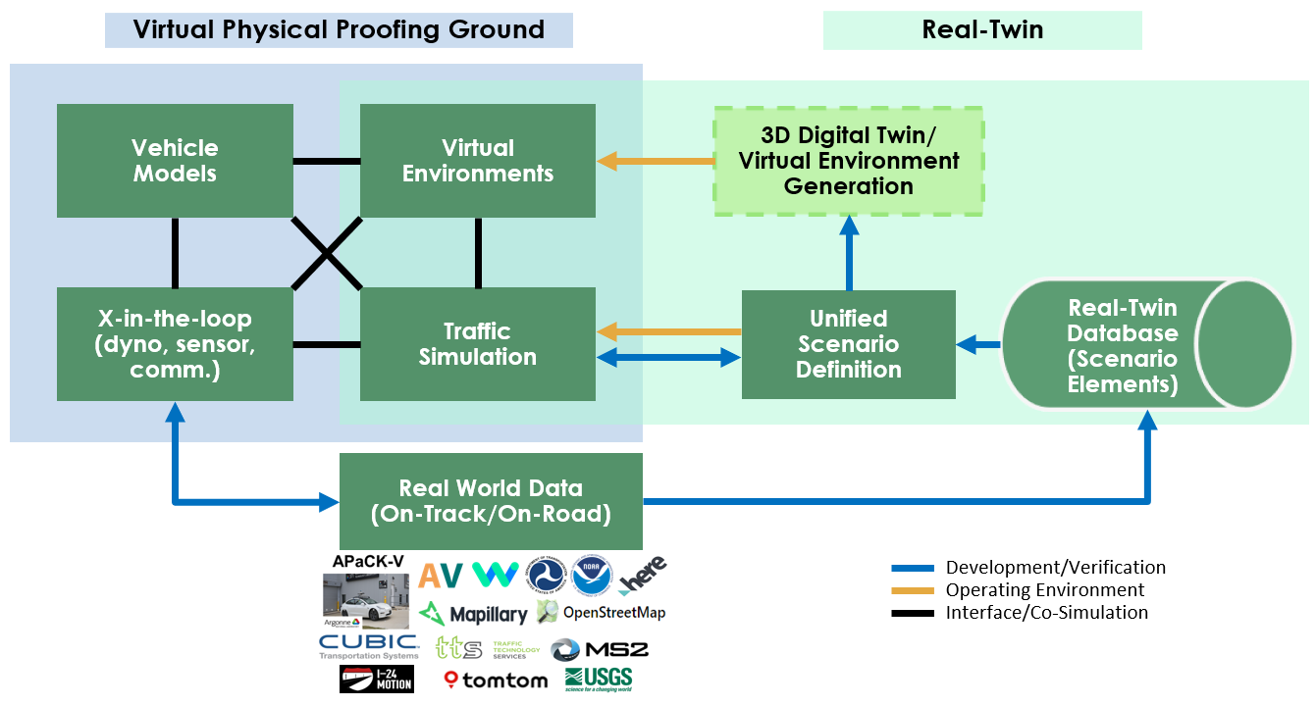
Research Motivation and Objective
Real-Twin for Realistic Scenario Generation for Standalone Traffic Simulation Studies
or for X-in-the-loop Studies
Real-Twin Tool Development
Provides a realistic scenario elements and attributes generation capability that ingests real data
Provides a twin for analyzing decarbonization opportunities and evaluating mobility objectives
Research Objective
This study presents a systematic approach to compare the closeness of traffic scenarios developed to study vehicle and traffic control strategies for improved mobility and energy consumption on different microsimulation software platforms
Notes:
Delivering a unified scenario generation capability that is equipped with well-defined workflows, integrated tools, and comprehensive metrics that streamline the scenario generation process for mobility technology evaluation.
oDescribe the objective of your project and what you were to achieve over the past year in the work covered by your presentation.
oClearly show how your project relates to the pertinent VTO subprogram area and how it will achieve the goals of that area (refer to the subprogram Annual Progress Report goals linked on the next page).
oExplain how your project will be relevant to Reduction of energy costs
Increased energy security
Clean energy technology to move people and goods
oDescribe the impact of your project on addressing the barriersidentified in the Overview slide and other specific targets and milestones.

Slide 5
Systematic Comparison Approach for Traffic Microsimulation Scenario Across Platforms
Key Gaps in Literature
Existing work mostly focused on the network-level comparison of overall traffic characteristics, while vehicle-level evaluation is needed for emerging vehicle and traffic control applications
Very few studies included a quantitative and systematic comparison of results from different microscopic simulation software
Comparative studies are needed as the modeling platforms and tools are constantly being updated

Slide 6
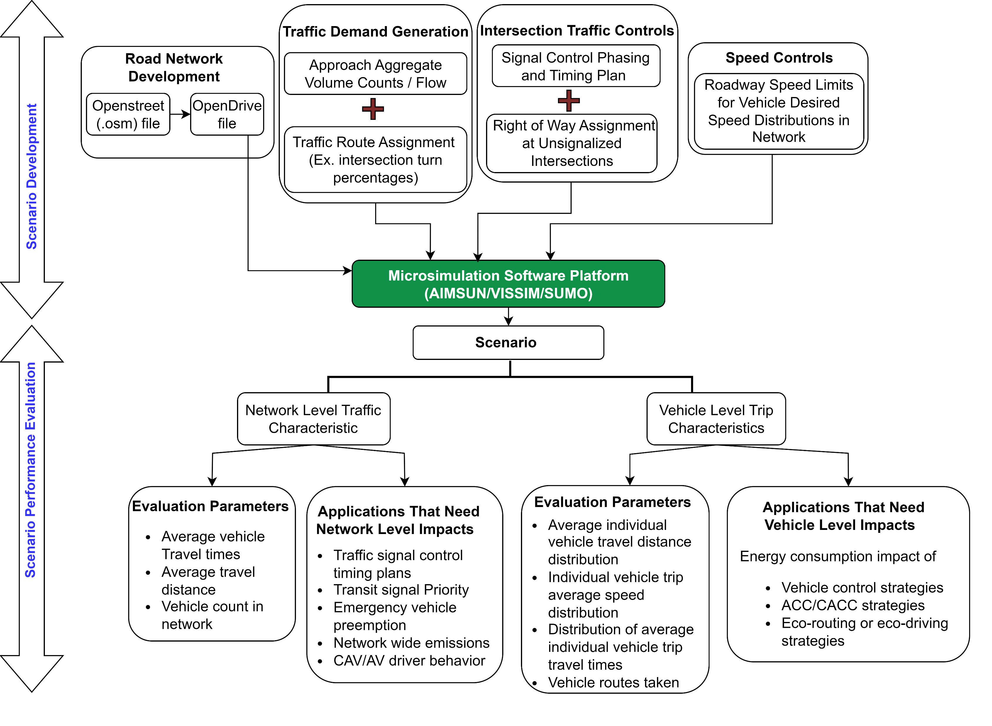
Systematic Comparison Approach for Traffic Microsimulation Scenario Across Platforms
Systematic comparison approach to investigate the closeness of traffic scenarios across different microsimulation software platforms
Scenario Development Comparison
Uniform inputs to the model
Software limitations
Scenario Performance Evaluation
Network level traffic characteristics
Vehicle level characteristics
KPI for comparison based on application of study

Slide 7




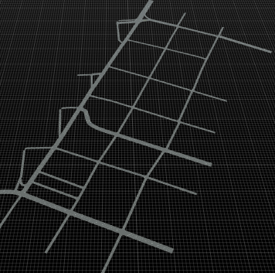
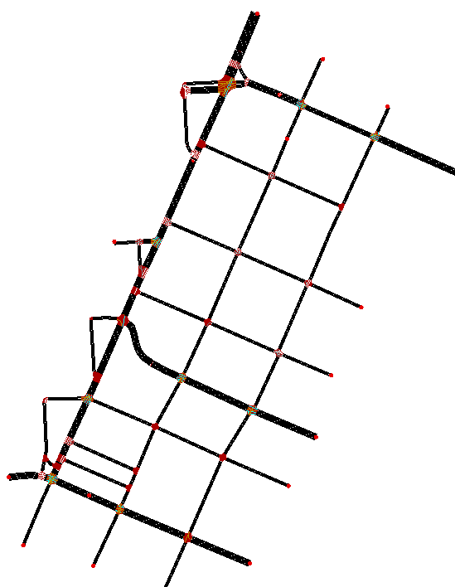
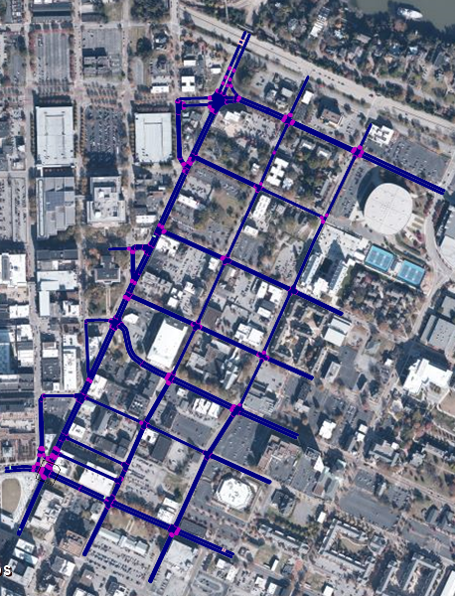
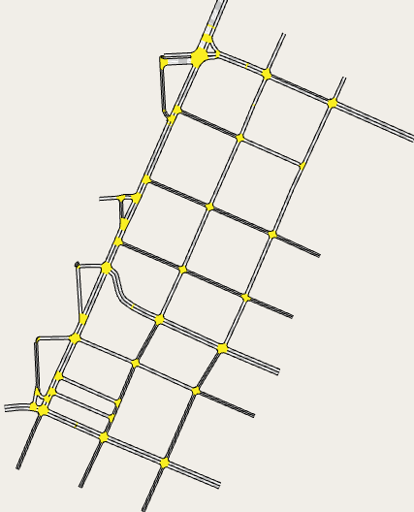
Case Study – Downtown Chattanooga, Tennessee
Comparison of the network development process and performance measures from the three microsimulation platforms – VISSIM, SUMO, and AIMSUN
Same scenario was created in the three platforms for a portion of the Downtown Chattanooga network
Scenario Development
Network Development – OpenDRIVE
Demand Generation
Traffic Controls
Speed Limits
Notes:
If an OpenDRIVE file is not provided by the user, the use of OpenStreetMap to generate an OpenDRIVE file is under investigation.

Slide 8
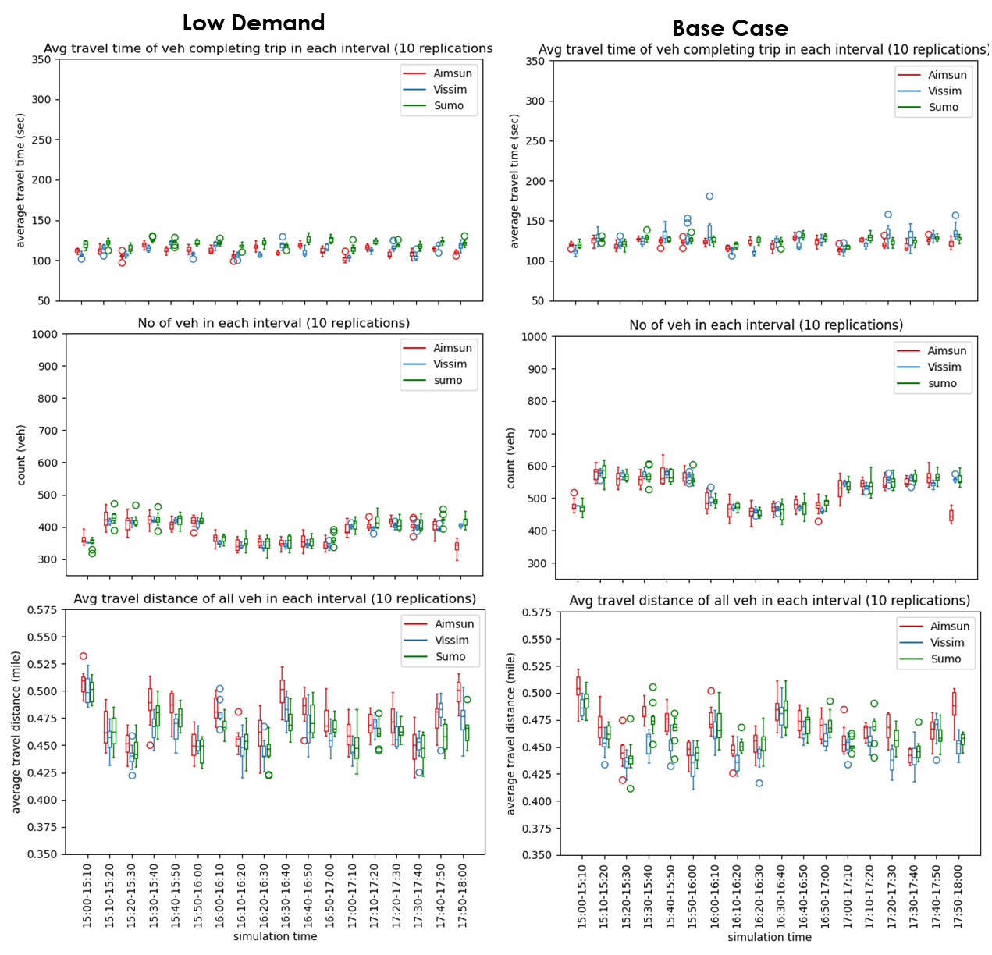
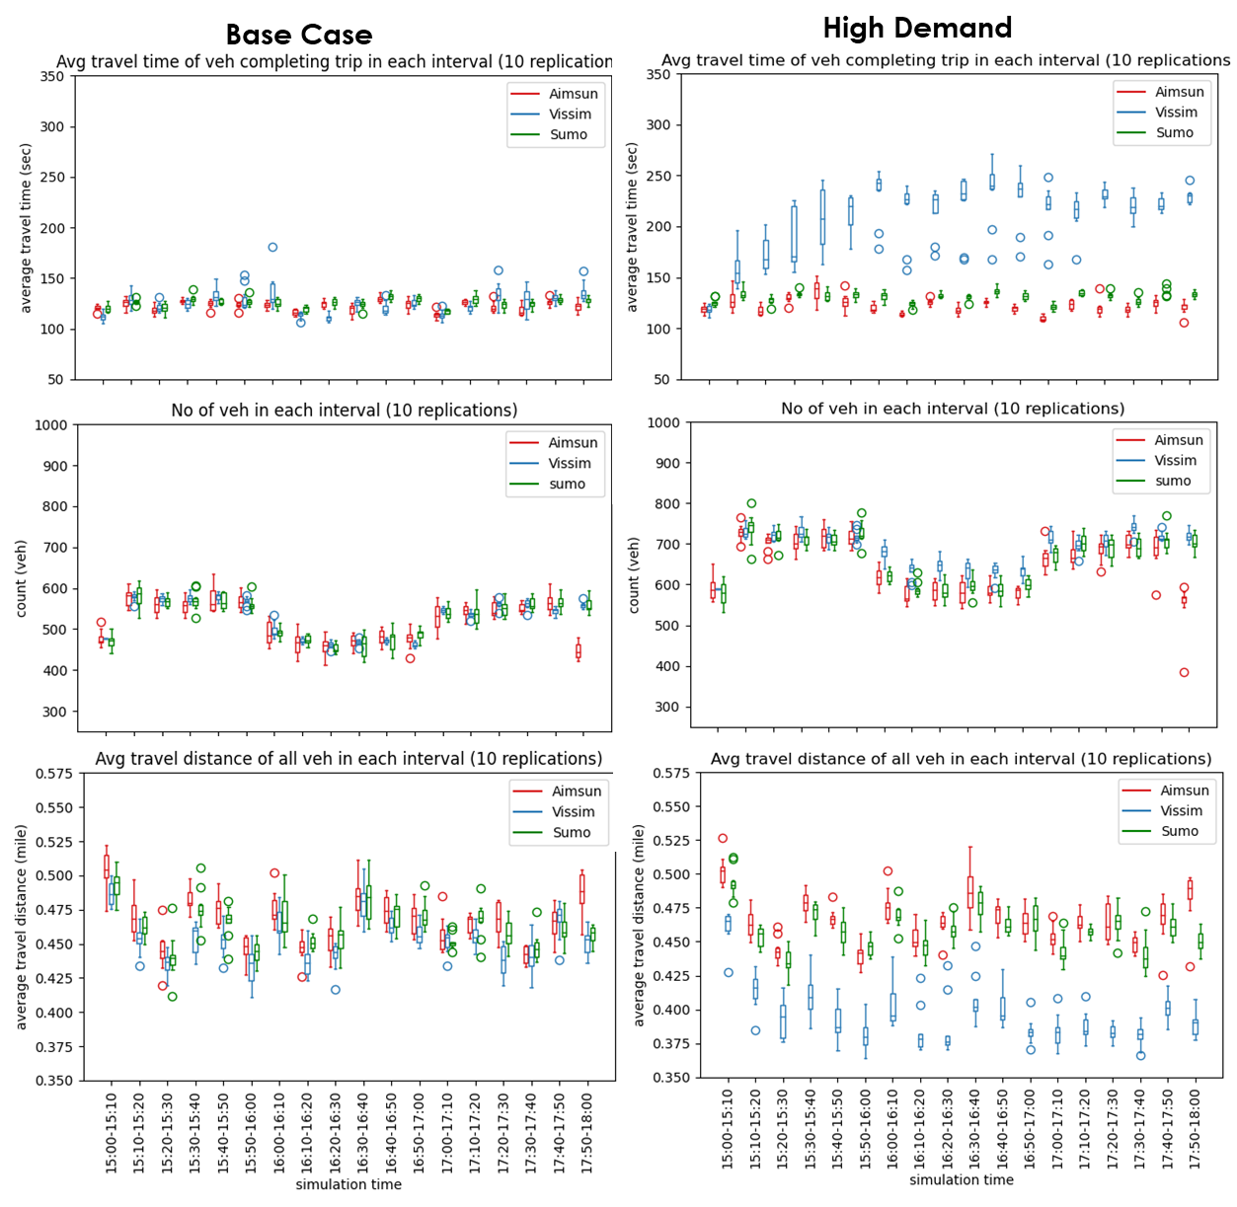
Case Study – Downtown Chattanooga, Tennessee
Network level comparison
Number of vehicles, average vehicle travel time, and average distance traveled in the time interval
Boxplots for 10 random seeds
Network level performance consistent for three platforms for low and base demand scenario but not for high demand
Notes:
If an OpenDRIVE file is not provided by the user, the use of OpenStreetMap to generate an OpenDRIVE file is under investigation.

Slide 9
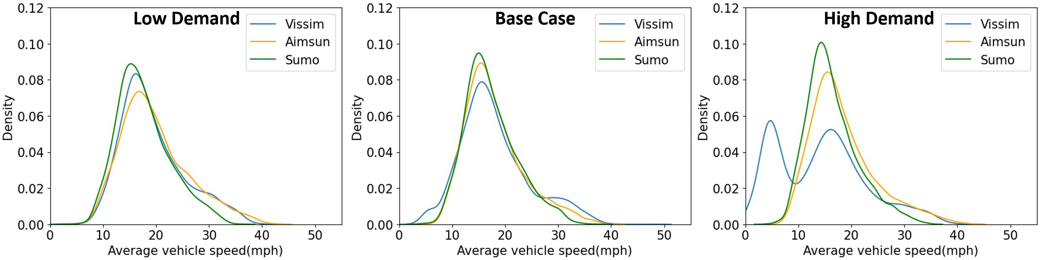
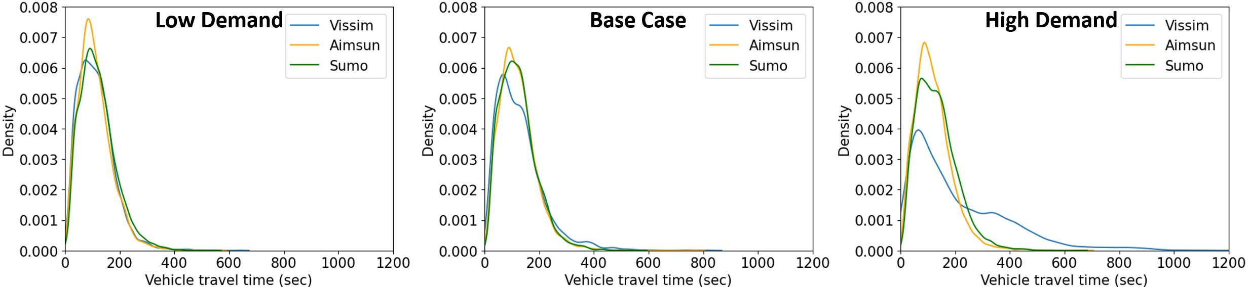
Case Study – Downtown Chattanooga, Tennessee
Vehicle Level Comparison
Base case and low-demand case show consistent vehicle-level results from the three platforms
High-demand case: VISSIM exhibit differences in average vehicle speed and average travel time distributions compared to AIMSUN and SUMO
VISSIM had a higher number of vehicles experiencing lower average speeds under higher demand
Differences in sensitivity of demand variation on vehicle-level performance in different software indicates a need for calibration to different demand scenarios
Notes:
If an OpenDRIVE file is not provided by the user, the use of OpenStreetMap to generate an OpenDRIVE file is under investigation.

Slide 10
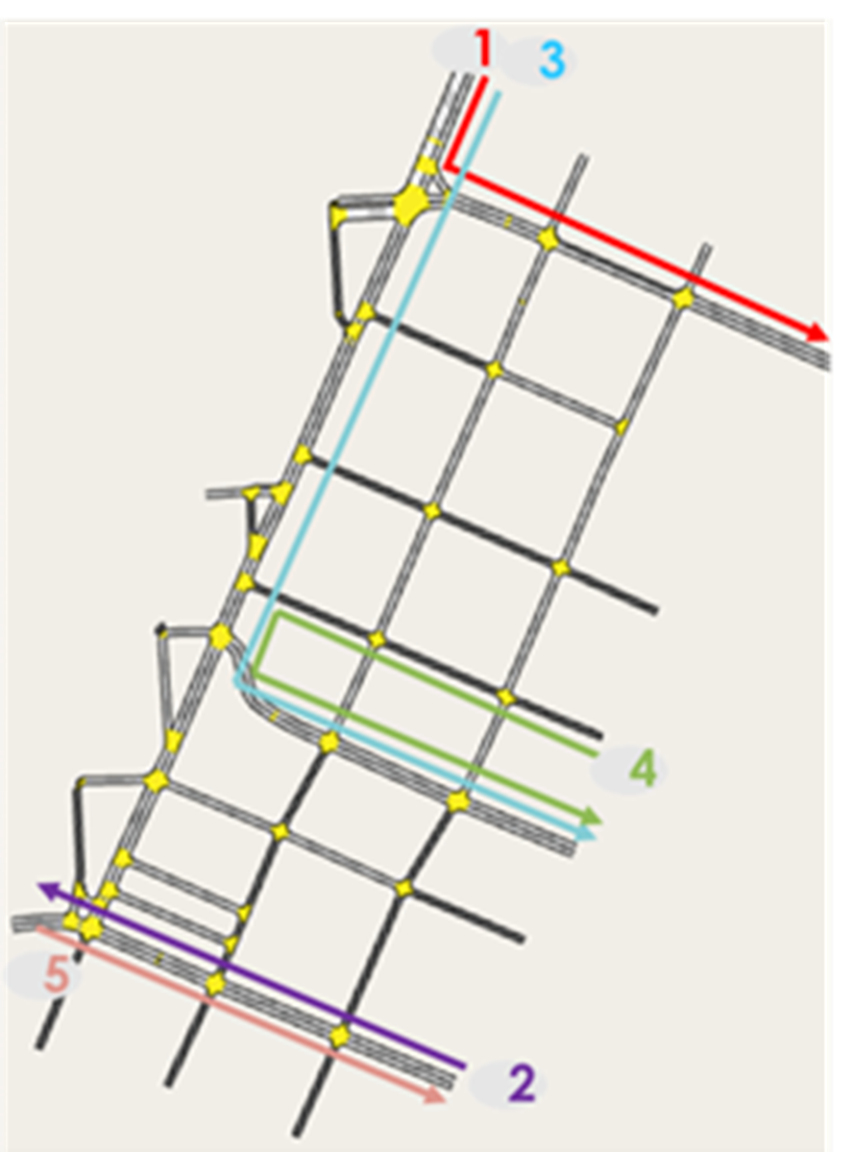
Case Study – Downtown Chattanooga, Tennessee
Vehicle Level Comparison
In simulation implementation, the vehicles were assigned a turn at each junction approach based on the turn ratios
The five most frequent routes and their orders were identical in the three platforms. However, the routes themselves may not be realistic (e.g., Route 4)
This routing behavior may not be a concern when studying mobility or energy impacts at the network level where primarily only aggregated traffic performance matters
Notes:
If an OpenDRIVE file is not provided by the user, the use of OpenStreetMap to generate an OpenDRIVE file is under investigation.

Slide 11
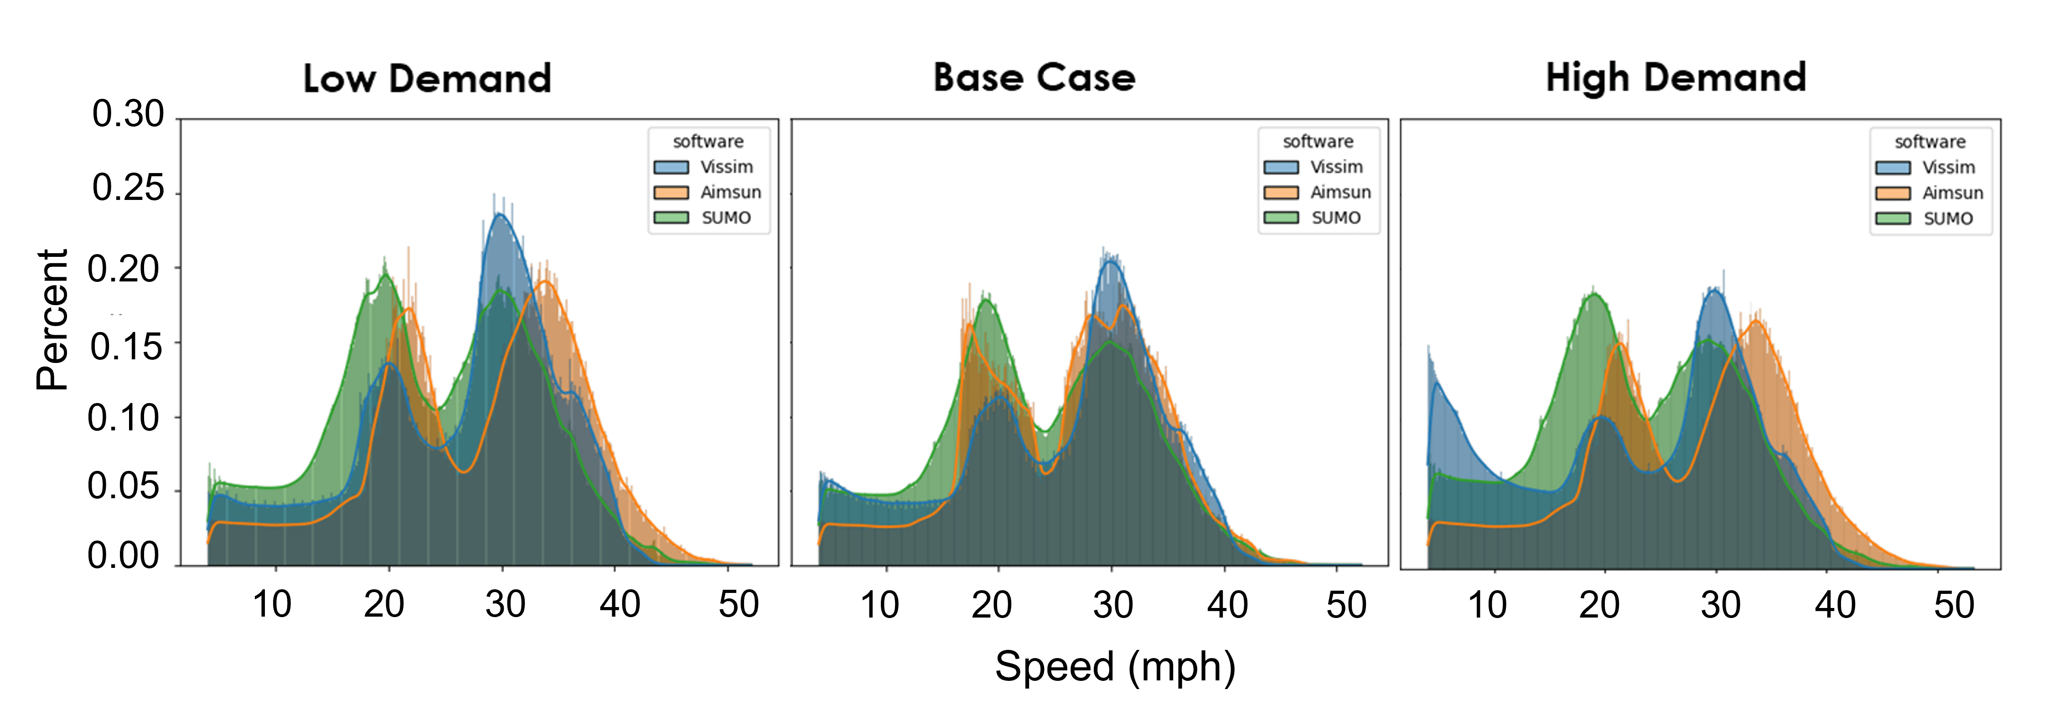
Case Study – Downtown Chattanooga, Tennessee
Vehicle Level Comparison
Higher vehicle speeds observed in AIMSUN for low and high demand cases
Increment in the frequency of vehicles with lower speeds from low demand to base to high demand for VISSIM
Calibration of desired speed distribution parameters for different demand scenarios is important for comparable scenario development across different platforms
Notes:
If an OpenDRIVE file is not provided by the user, the use of OpenStreetMap to generate an OpenDRIVE file is under investigation.

Slide 12
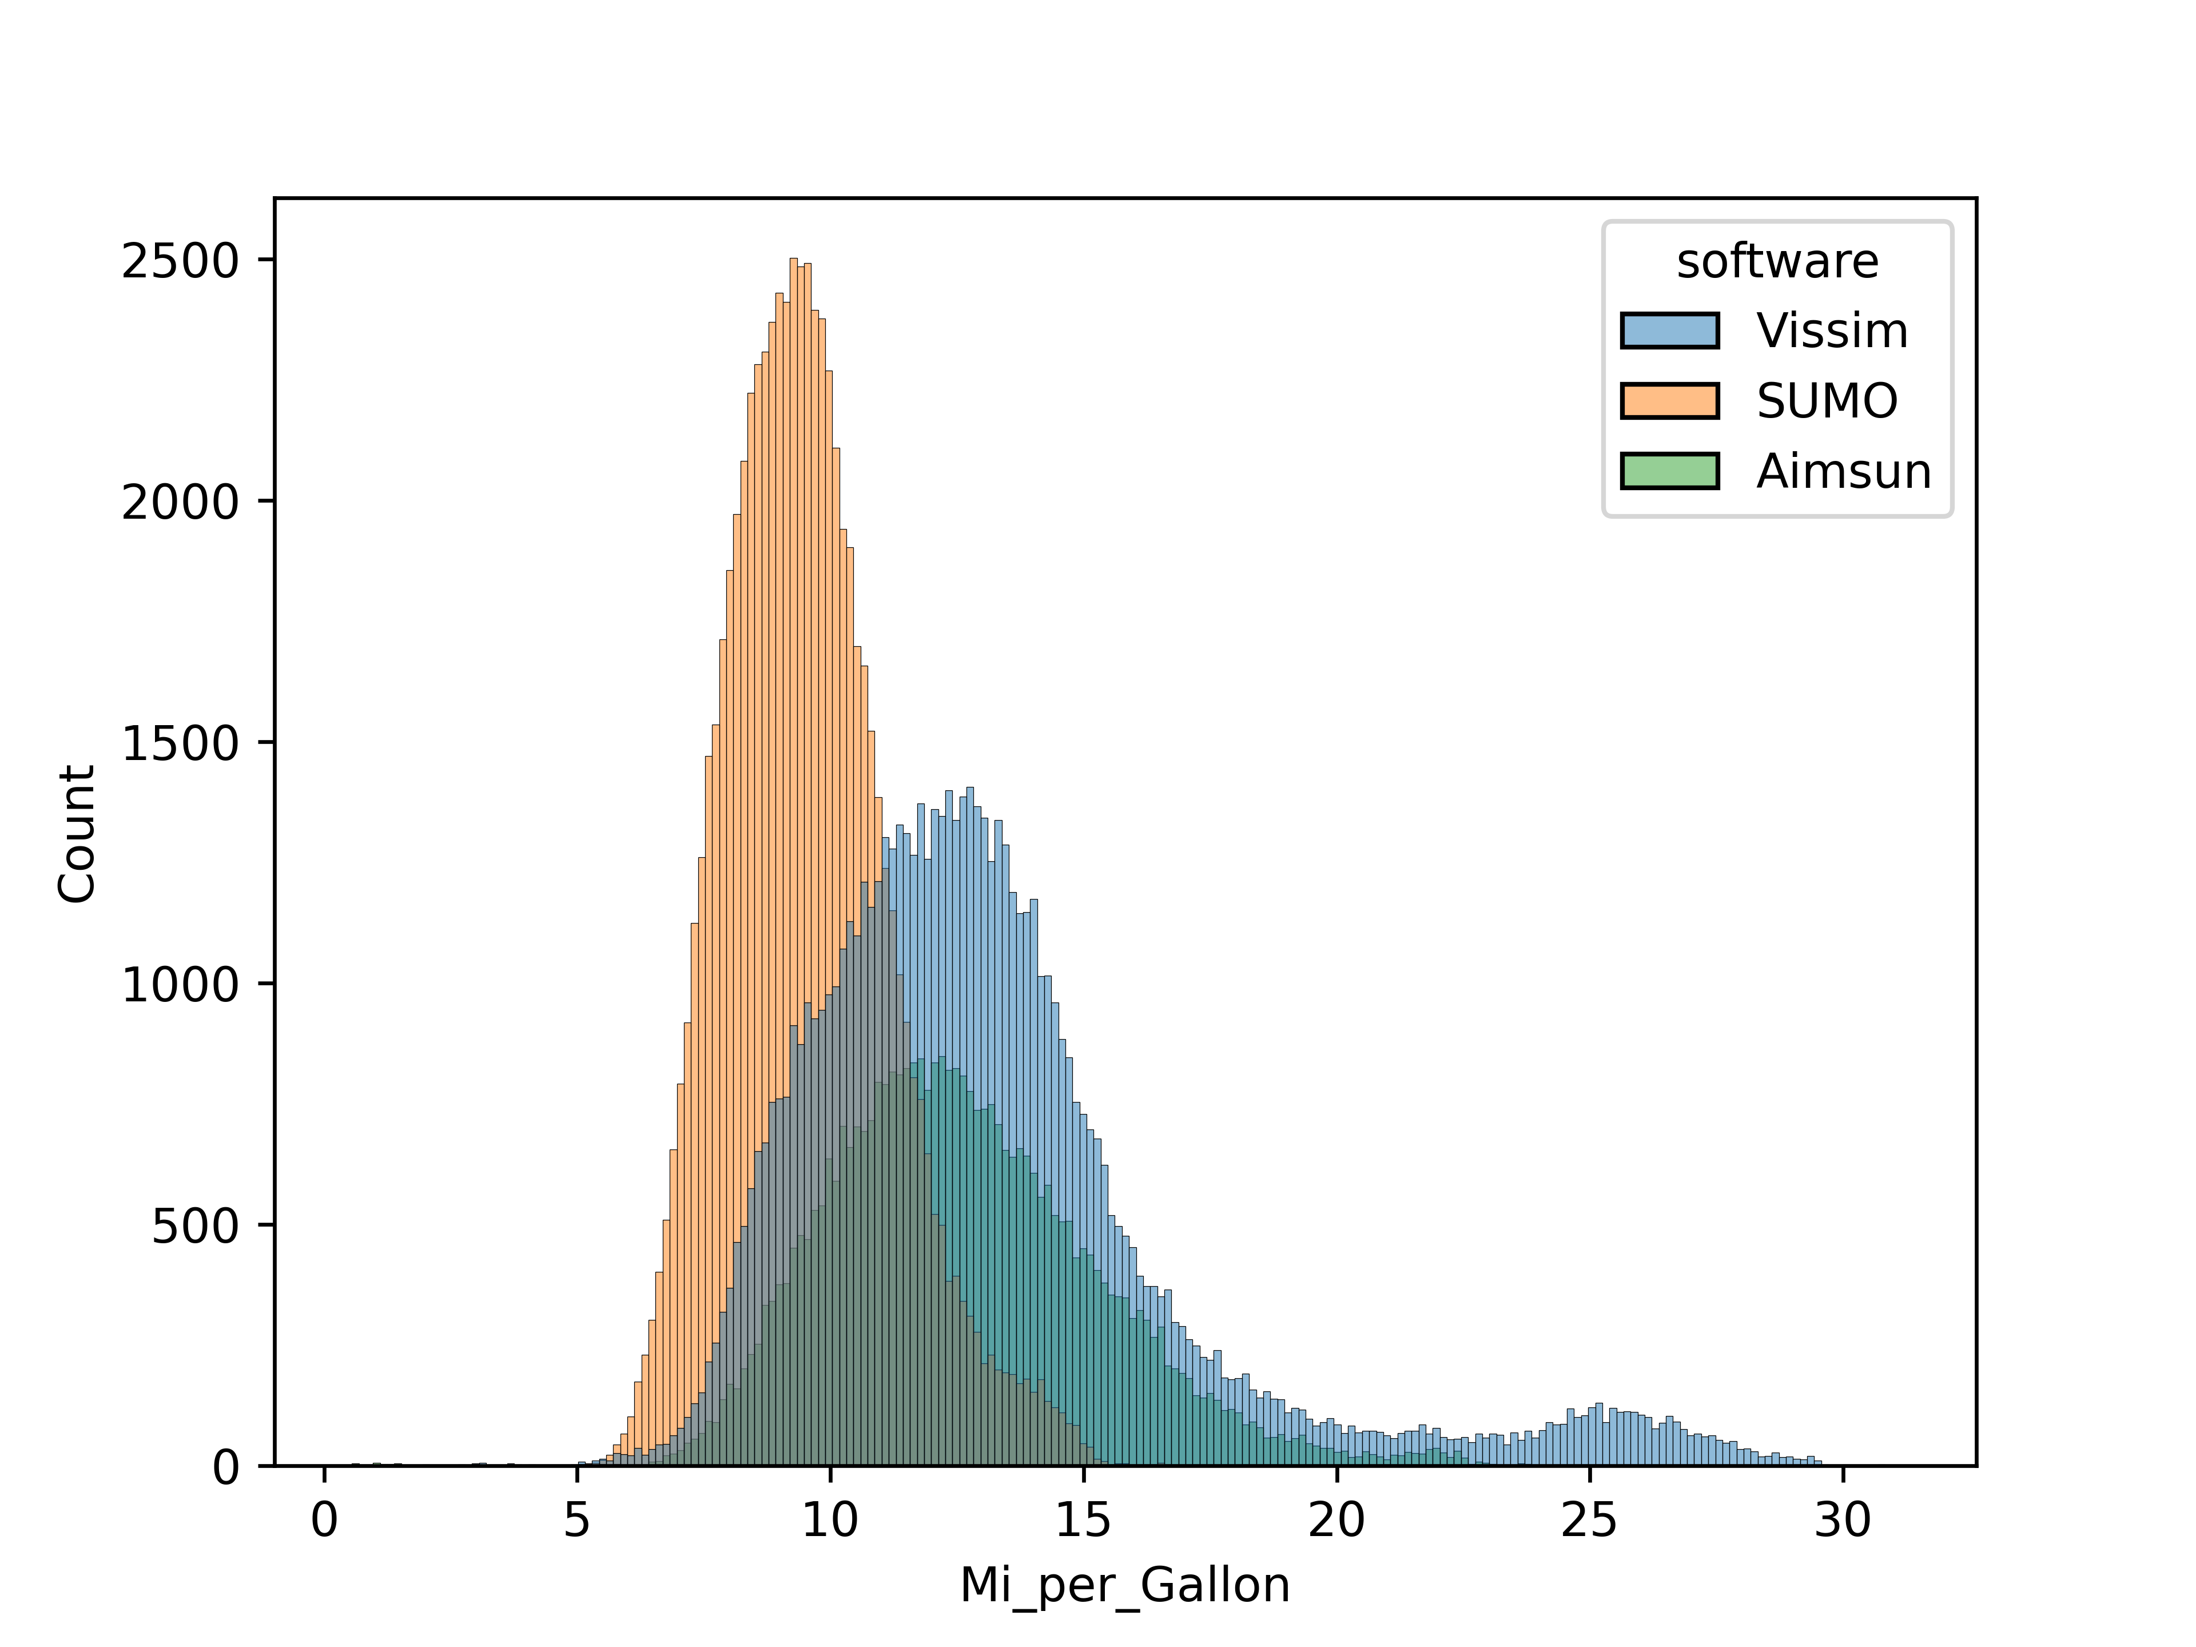
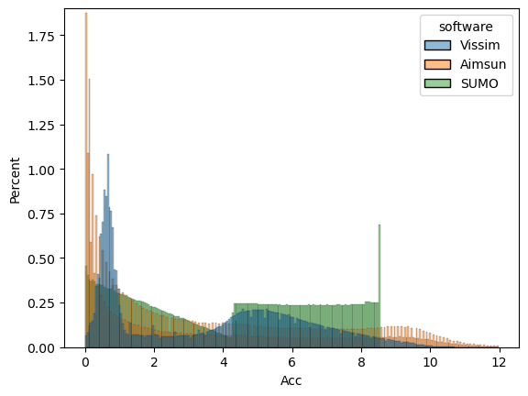
Case Study – Downtown Chattanooga, Tennessee
Vehicle Level Comparison – Preliminary Investigation for Energy Consumption Impacts
Vehicle Inst. Acc. Distribution
Acceleration (>0 and < 12 fps²)
Vehicle Fuel Efficiency Distribution
Although network and vehicle level traffic performance measures similar energy consumption values differ
Shows the importance of calibrating acceleration-related parameters such as desired acceleration/deceleration distribution, maximum acceleration/deceleration distribution, car following parameters, etc., especially for energy-focused applications
Notes:
If an OpenDRIVE file is not provided by the user, the use of OpenStreetMap to generate an OpenDRIVE file is under investigation.

Slide 13
Key Conclusions
Comparison of scenario development:
OpenDRIVE files can be imported into the three software compared in this study
Compared to AIMSUN and SUMO, VISSIM has the more comprehensive and complex underlying simulation models and requires attention to further calibrate the network layout
Comparison of scenario performance evaluation:
For the base and the low demand cases, the network traffic characteristics and individual trip characteristics for the three software were consistent
Potential and effectiveness of using the scenario development approach followed in the paper to achieve consistent traffic simulation across different microscopic simulation platforms
Higher travel times with more variations across different random seeds were observed in VISSIM compared to SUMO and AIMSUN in the high demand case. This indicated VISSIM results in more stochasticity than SUMO and Aimsun
Vehicle fuel efficiency distributions in the base case scenario reveals that although conventional traffic characteristics are similar across the software, the fuel efficiency distributions and acceleration distributions differ
Need to calibrate driving behavior and acceleration distribution specific parameters for consistent scenario generation for energy consumption-focused applications

Slide 14
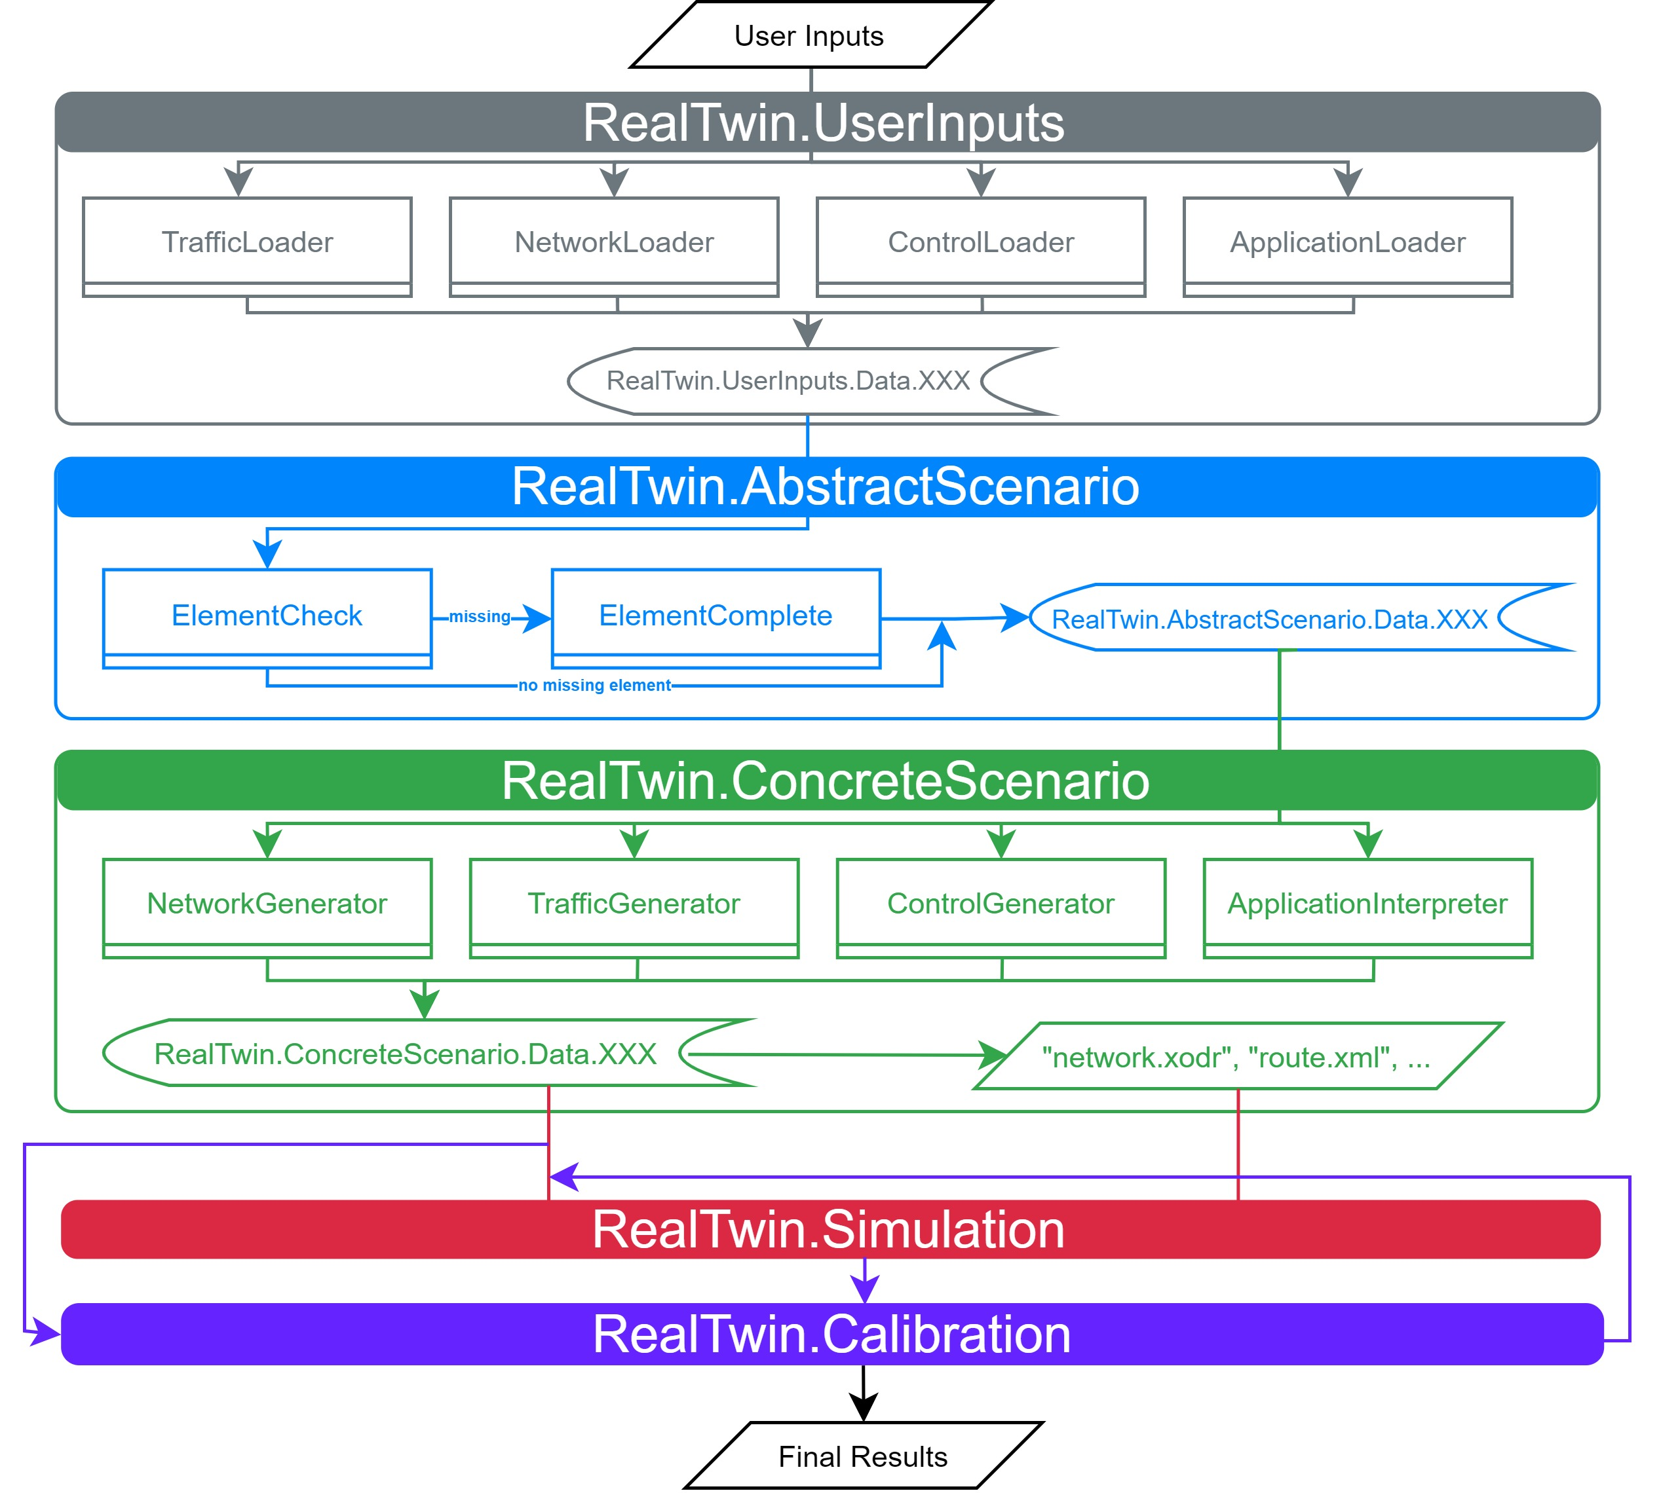
Progress on Real-Twin Tool
RealTwin Classes UserInputs, AbstractScenario, and ConcreteScenario to prepare all inputs – network, traffic, controls, and application parameters for the RealTwin.Simulation to generate simulation scenario in Aimsun, VISSIM and SUMO.
Data from User Input File
Traffic:
Volume
Turning Ratio
Network:
Network Name
Network Bounding Box Vertices Coordinates (latitude, longitudes)
Elevation Map
Control:
Signal Timing Plan in UTDF format
Application:
Application Type. e.g., AV
Simulator
Car Following Model
Car Following Behavior Parameter Values
UserInput.yaml
Intermediate Variables
(storing user-provided input data)
Intermediate Variables from Traffic
Intersection Name, Latitude, Longitude, Approach, Interval Start Time, Interval End Time, Turn Movement Type, Count
Intermediate Variables
(storing scenario elements with ID matched with OpenDRIVE network)
Intermediate Variables from Traffic include OpenDRIVE ID
Intersection Name, Latitude, Longitude, Interval Start Time, Interval End Time, Turn Movement Type, Count, OpenDRIVE ID

Slide 15
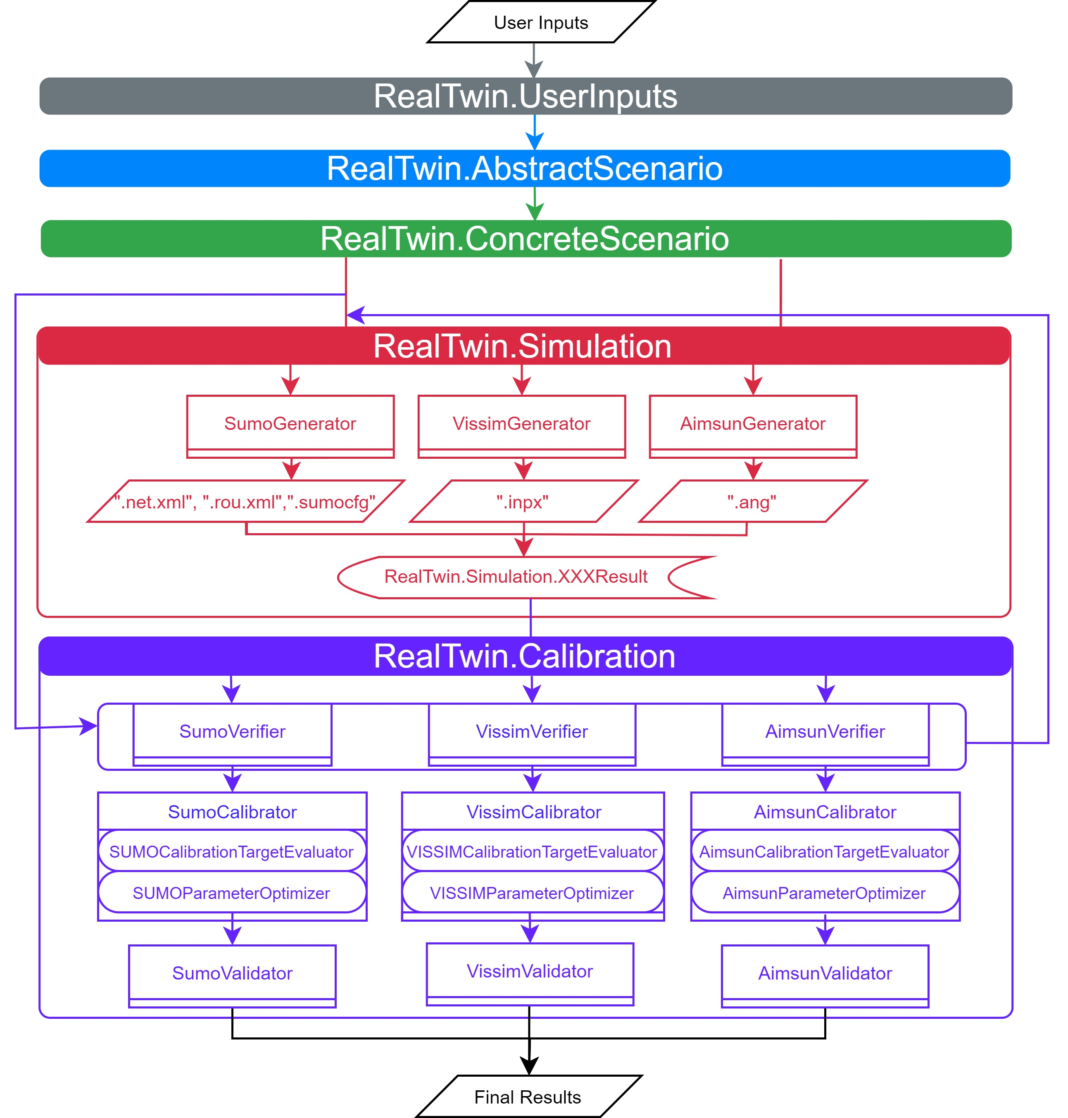
Progress on Real-Twin Tool
RealTwin Classes Simulation and Calibration used to generate simulation scenario in Aimsun, VISSIM and SUMO and to calibrate them.
Intermediate Variables
(intermediate variables updated to map with network and include all scenario elements)
Network, Demand, Controls, and Application Parameters from ConcreteScenario used by the Simulation to generate scenario using the respective simulator.
Simulated scenario is calibrated in the Calibration module:
Verifiers. Simulation outputs and ConcreteScenario intermediate variable values compared to verify simulation inputs.
Calibrators. Calibrators include:
CalibrationTargetEvaluators to estimate calibration target measures.
ParameterOptimizers to optimize the parameters to reach the calibration target measure goal.
Validators. Validate the verified and calibrated model with real-world data.

Slide 16
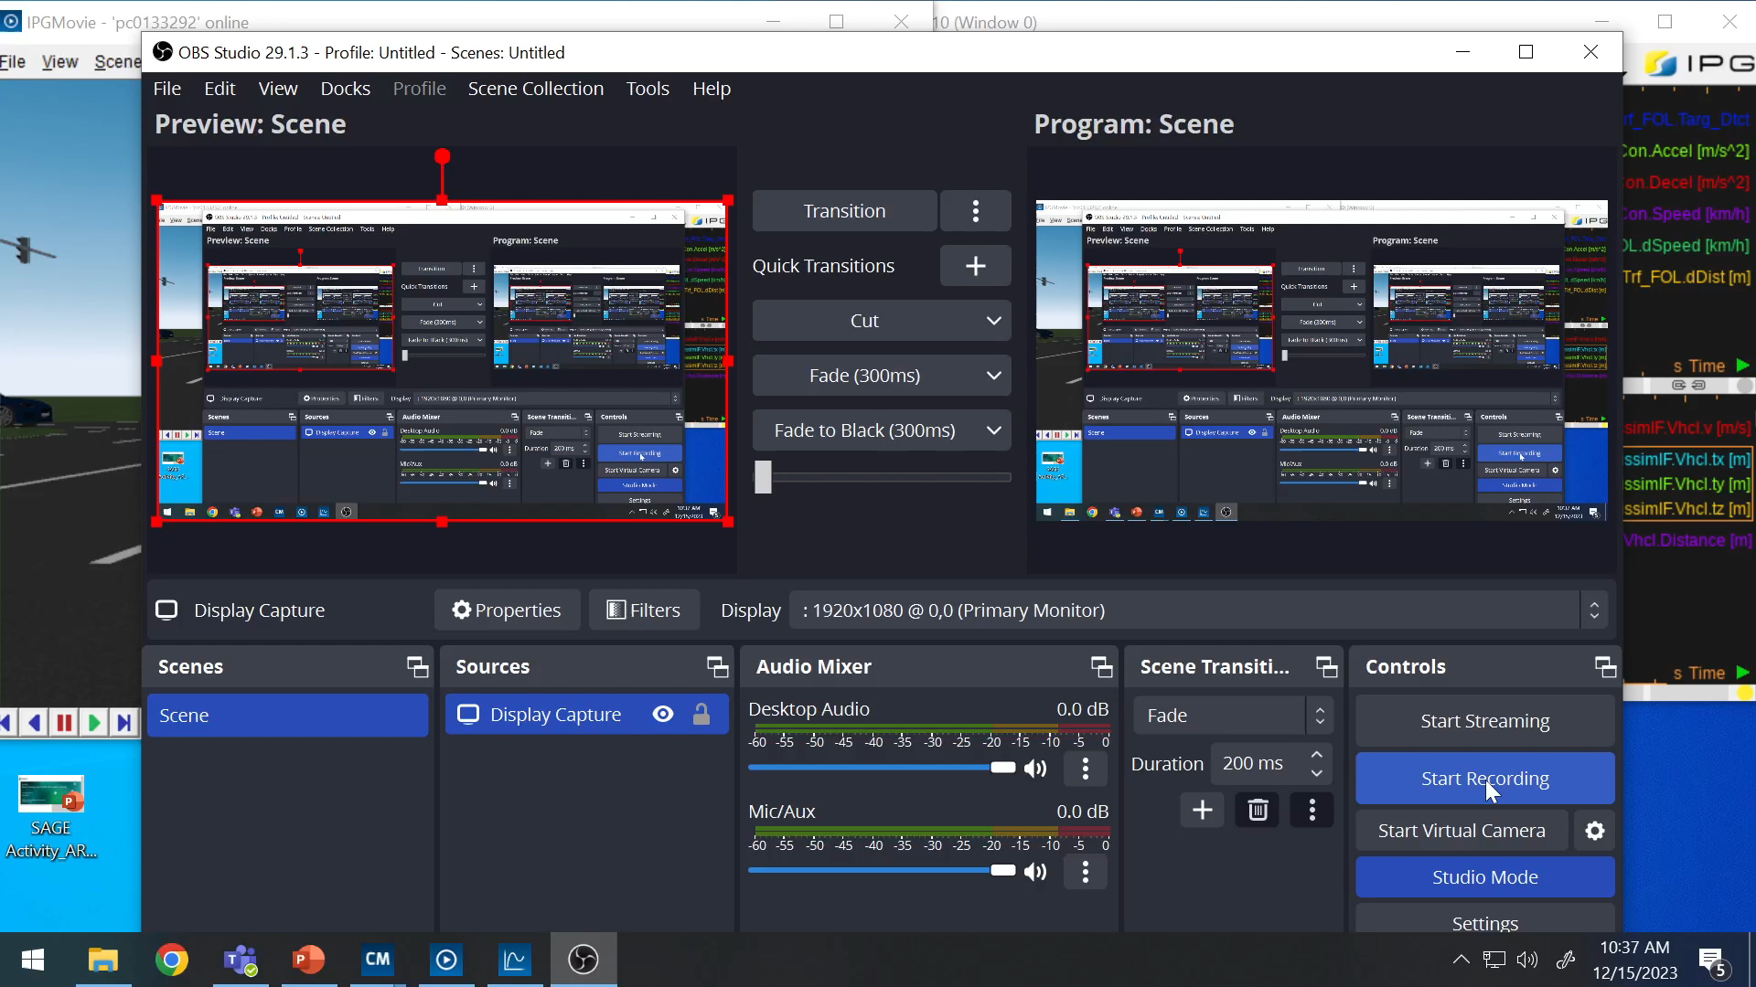
Use Case of Real-Twin for XIL Cosimulation
IPG CarMaker +Vissim Co-simulation

Slide 17
Thank you Questions?

Slide 18
Backup slides

Slide 19
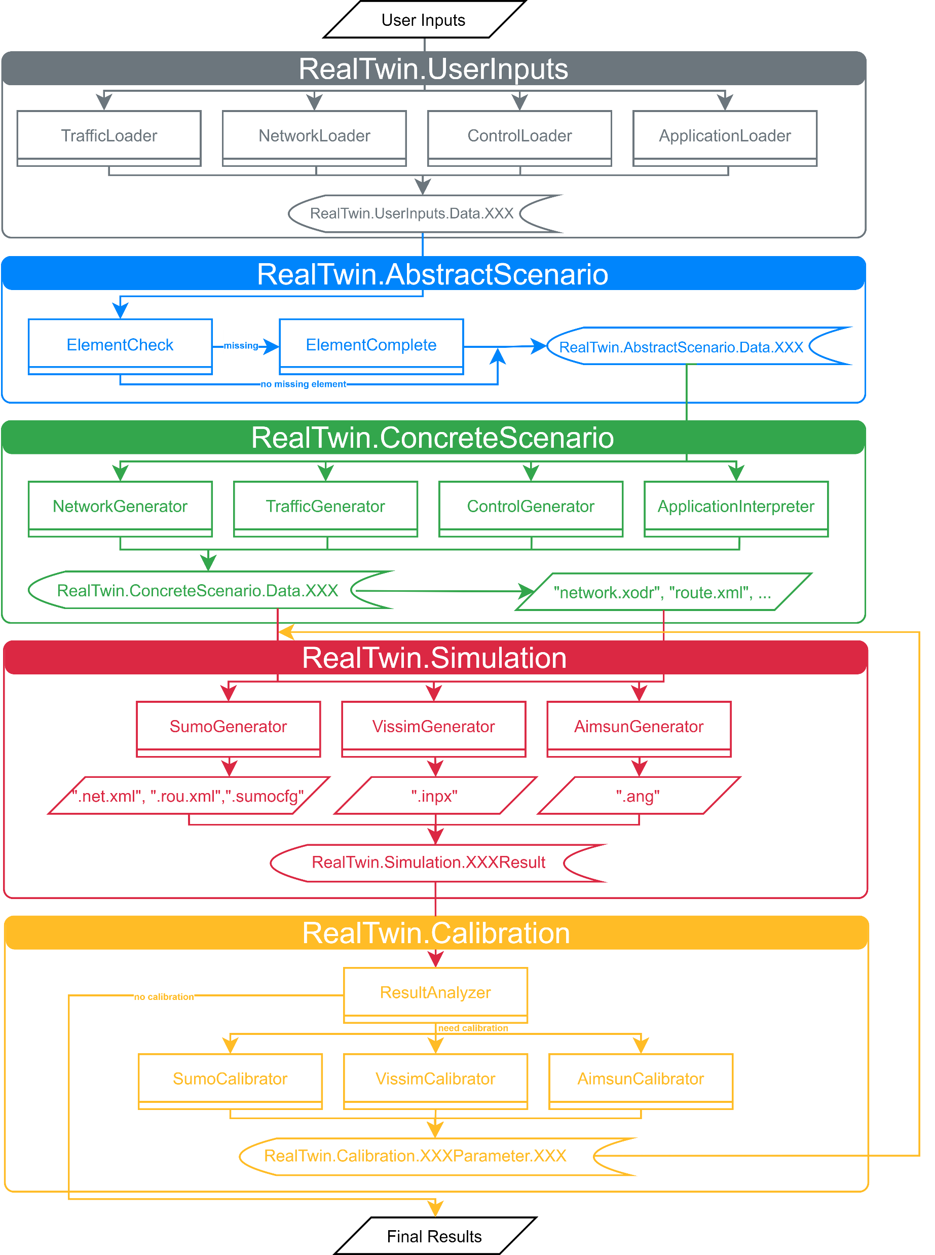
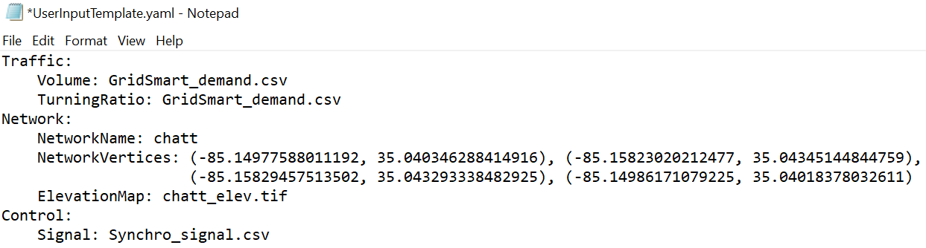
UserInput Template
UserInputTemplate.yaml

Slide 20
Traffic
Traffic: Volume: count.csv TurningRatio:turn.csv
UserInputTemplate.yaml
pd.DataFrame(data, dtype = {'IntersectionName':str, 'IntervalStart':int, 'IntervalEnd':int, 'Turn':str, 'Count':int})
Intermediate variable
Intermediate variable(using ID from OpenDrive)
pd.DataFrame(data, dtype = {'IntersectionName':str, 'IntervalStart':int, 'OpenDriveFromID':int, 'Count':int})
<routes> <vType id="car"/> <vehicle id="4.0" type="car" depart="28803.52"> <route edges="-280 -307 -327 -281 -314"/> </vehicle> <vehicle id="4.1" type="car" depart="28808.47"> <route edges="-280 -307 -327 -281 -314"/> </vehicle>
chatt.rou.xml

Slide 21
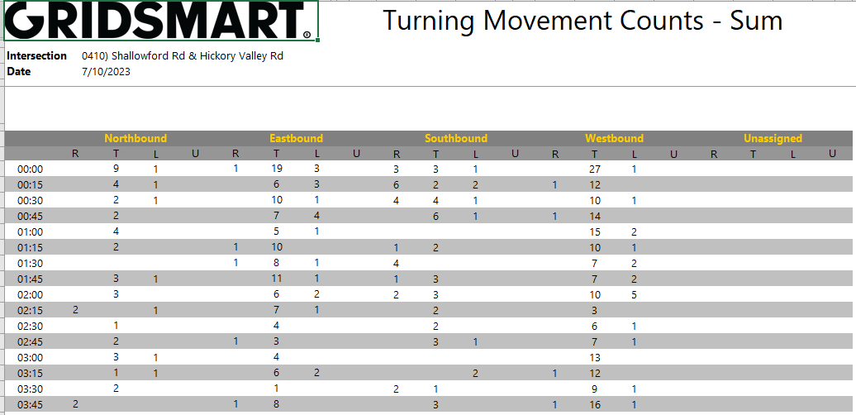
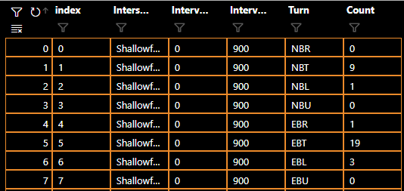
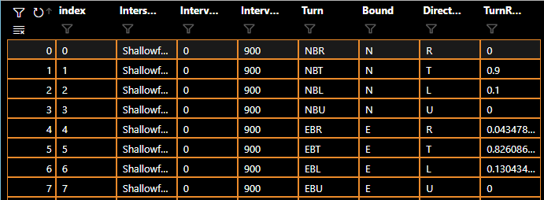
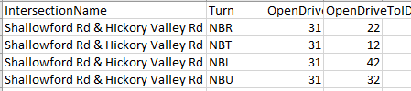
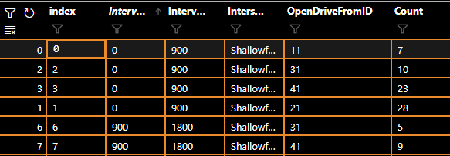
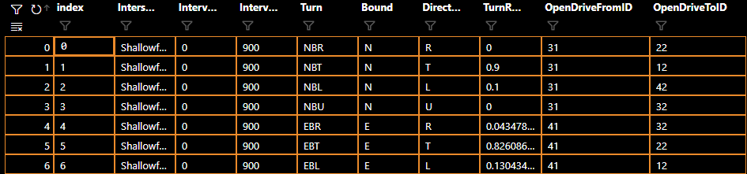
Traffic
UserInputs
Volume
Turning Ratio
AbstractScenario
lookup table
ConcreteScenario

Slide 22
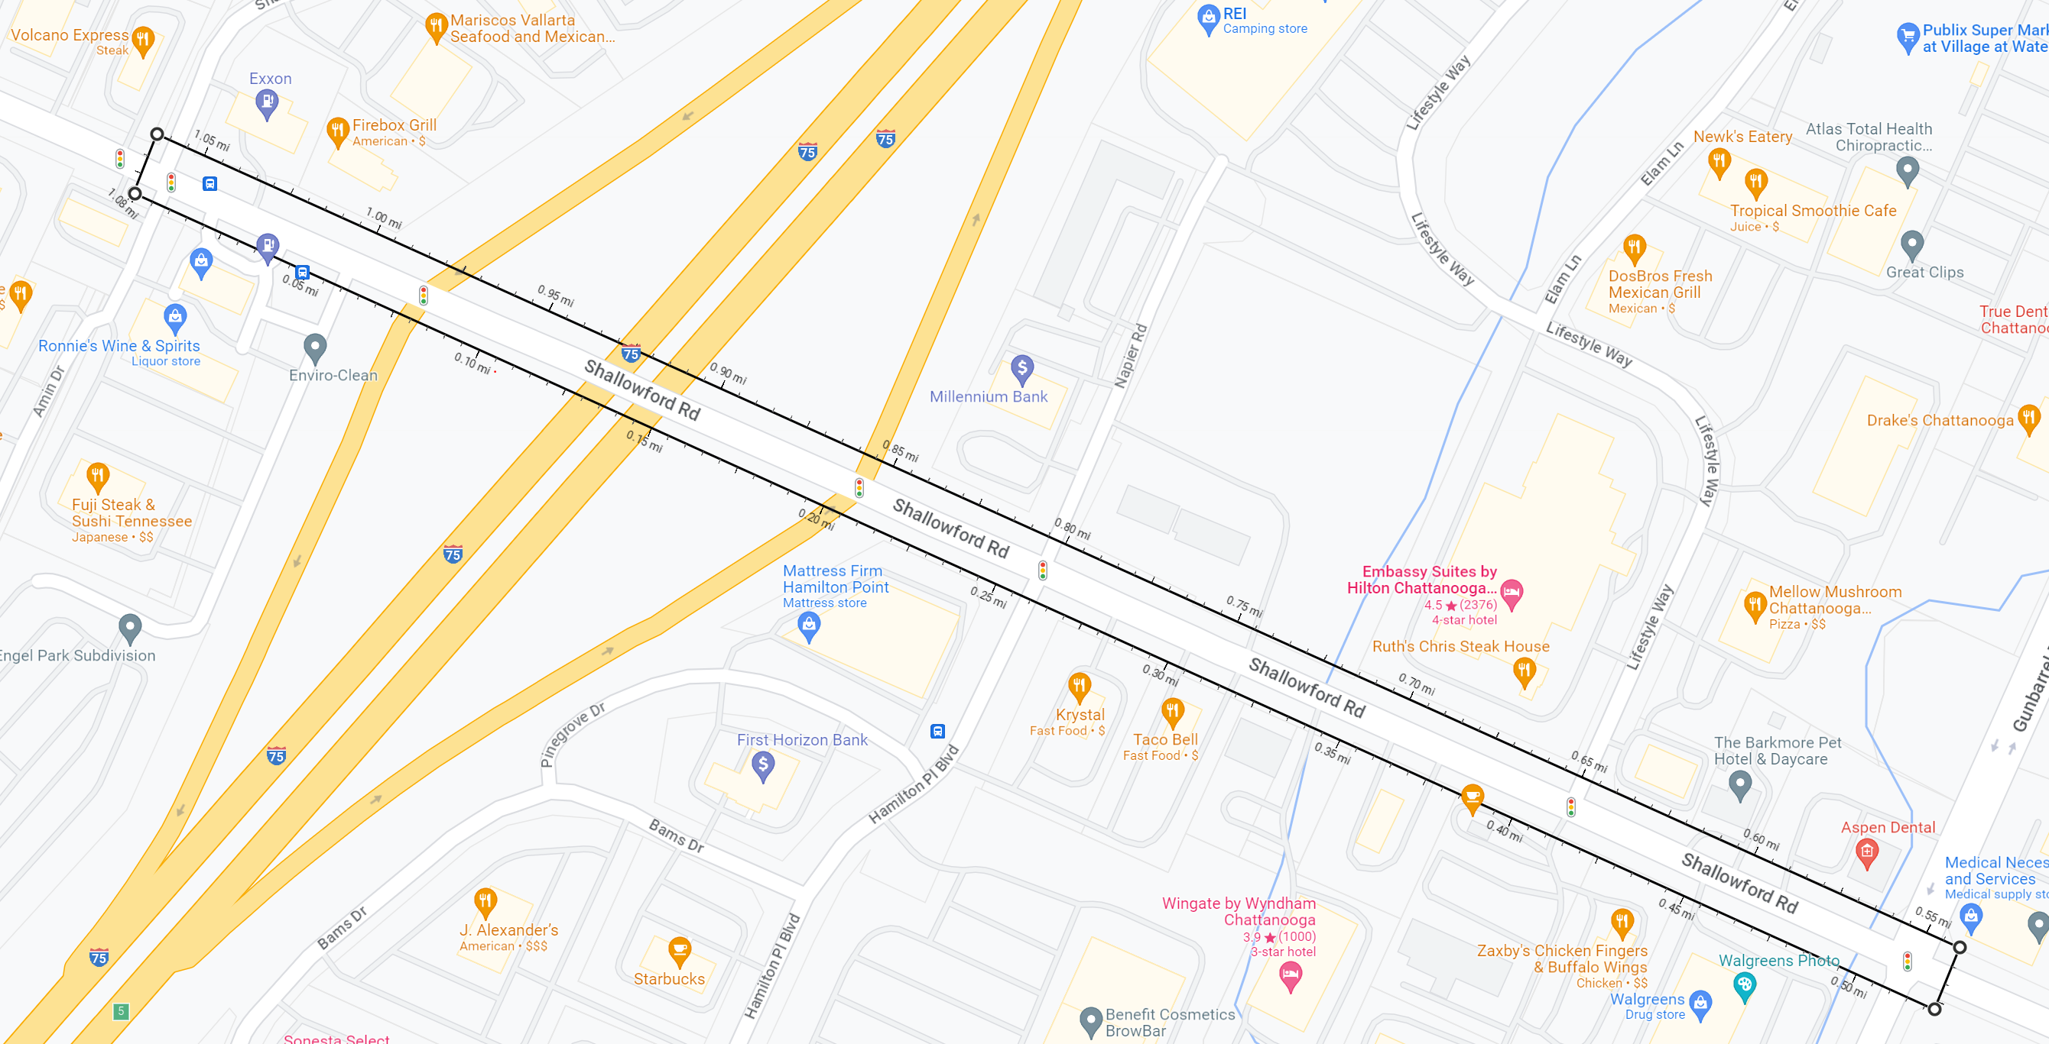
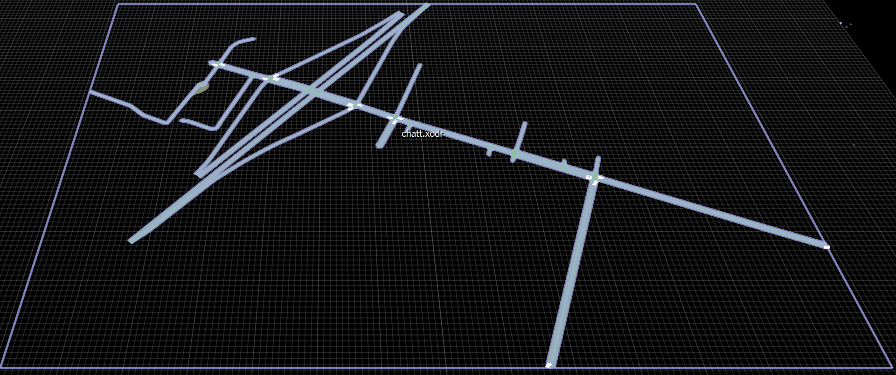
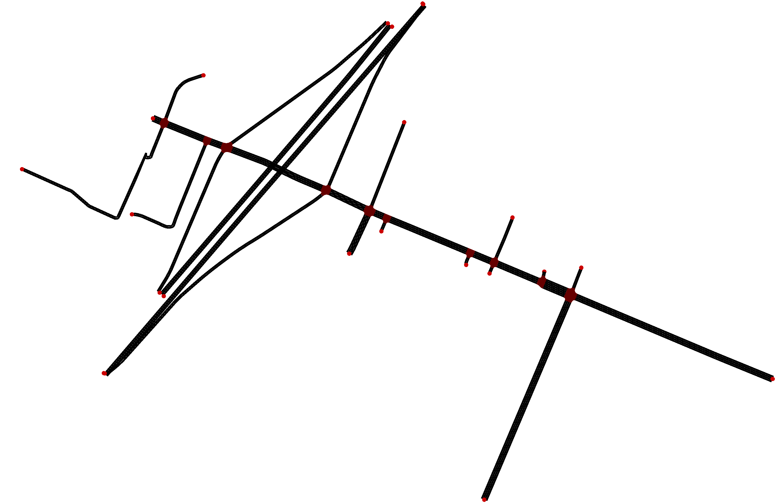
Network: NetworkName: chatt NetworkVertices: (long1, lat1), (long2, lat2), (long3, lat3), (long4, lat4) ElevationMap: chatt_elev.tif
Network
UserInputTemplate.yaml
chatt.xodr (raw)
chatt.xodr (with updated elevation)
chatt.net.xml

Slide 23
Control
Control: SignalPlan: signal.csv (Synchro Universal Traffic Data Format(UTDF) file)
UserInputTemplate.yaml
Intermediate variable
pd.DataFrame(data, dtype = {'IntersectionID': int,'PhaseID': int, 'Green': float, 'yellow': float, 'NBL', bool, 'NBT', bool, 'NBR', bool… }
Intermediate variable(using ID from OpenDrive)
<tlLogic id="8" type="static" programID="0" offset="0"> <phase duration="8.4" state="rrrrrrrrrrGG"/> <phase duration="3.0" state="rrrrrrrrrryy"/> ... <param key="linkSignalID:0" value="202556079_0"/> <param key="linkSignalID:1" value="202556079_0"/> ... </tlLogic>
tlLogic in chatt.net.xml

